Slide 1

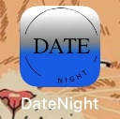
Michael Gates’ Senior Project
Date Night
iOS App

Slide 2
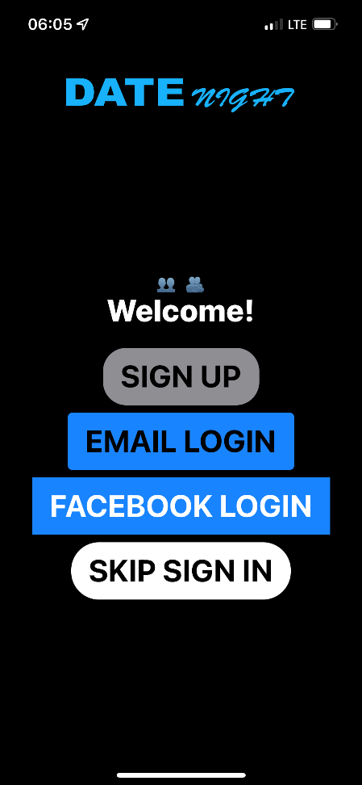
Date Night
Fully programmed on xcode using swift.
Sign in/up screen with option to just get into the app to see what's around.
iOS keeps track of a bind I set to track if a user is logged in or if they skipped the login and only displays this screen if a user logs out or has not logged in yet.

Slide 3
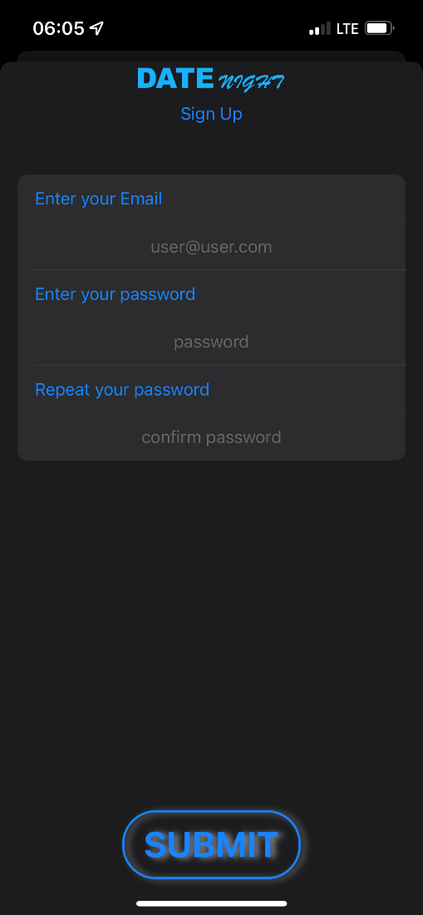
Sign Up View
Sign up screen was supposed to use firebase authentication but pods does not like M1 macs.
The views are still there for when I can get pods working.
pods is how you install third party extensions into xcode.

Slide 4
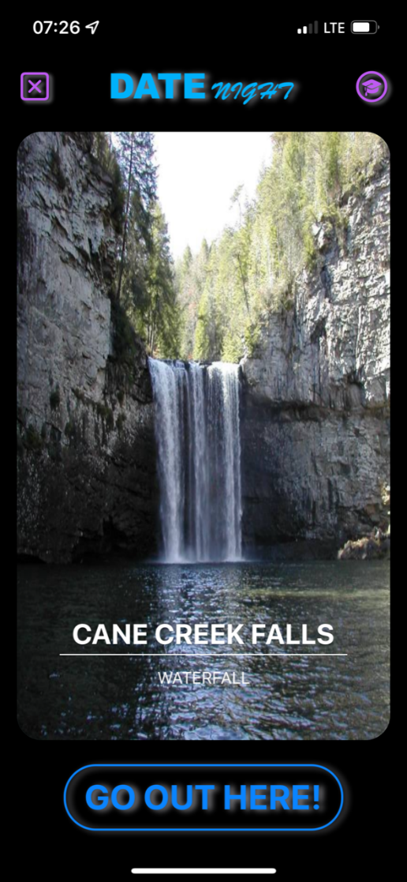
Main Screen
Main screen consists of a logout button, an about button, and a “Go Out Here” button.
I used public pictures from Facebook after reviewing the policy on using public pictures from establishments to verify that I could use them for this project.

Slide 5
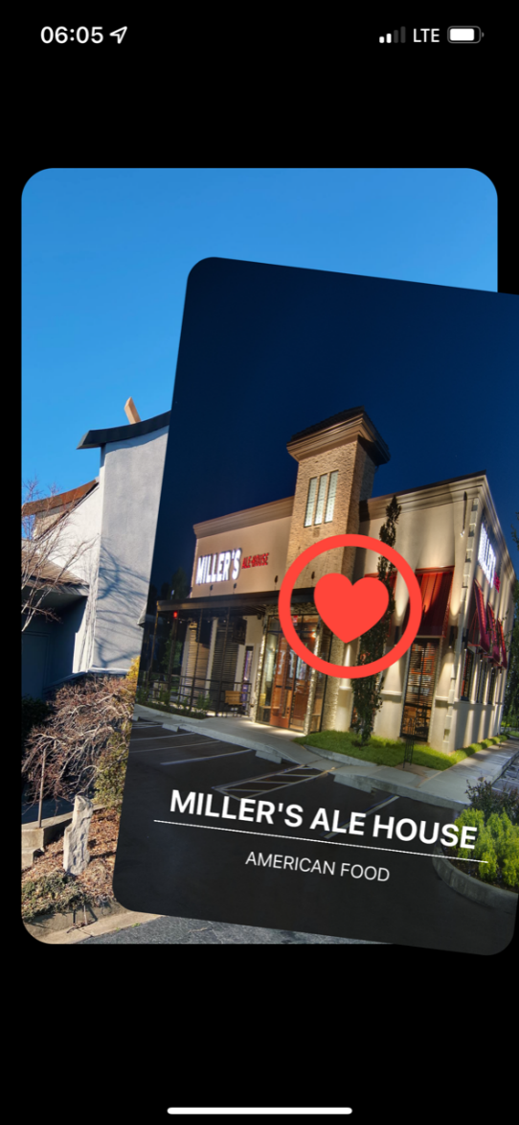
Swipe right
Swipe right if you like the location and want to try it later.
The cards pivot around a point I set near the bottom of the display.

Slide 6
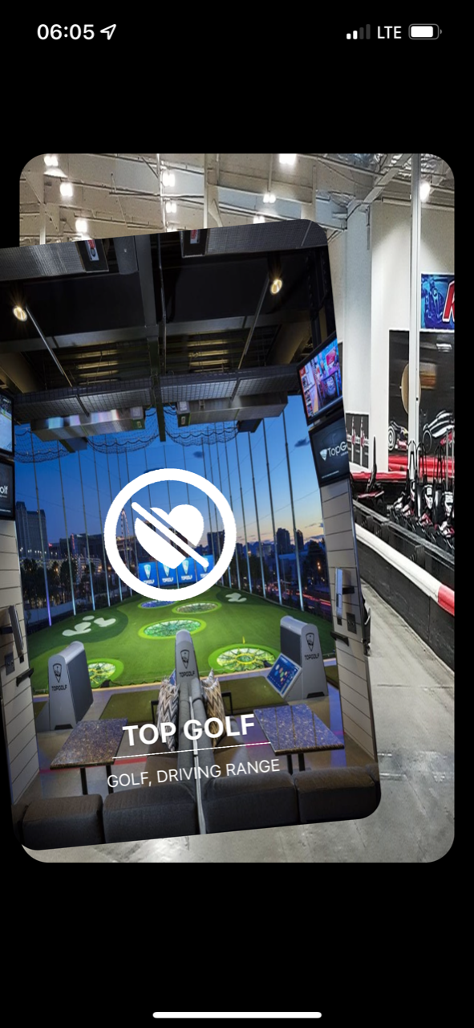
Swipe left
Swipe left if you want to remove the location and never see it again.
This is controlled by binding a Boolean value to each card and setting it to false. The Boolean value is checked before it displays a new card.

Slide 7
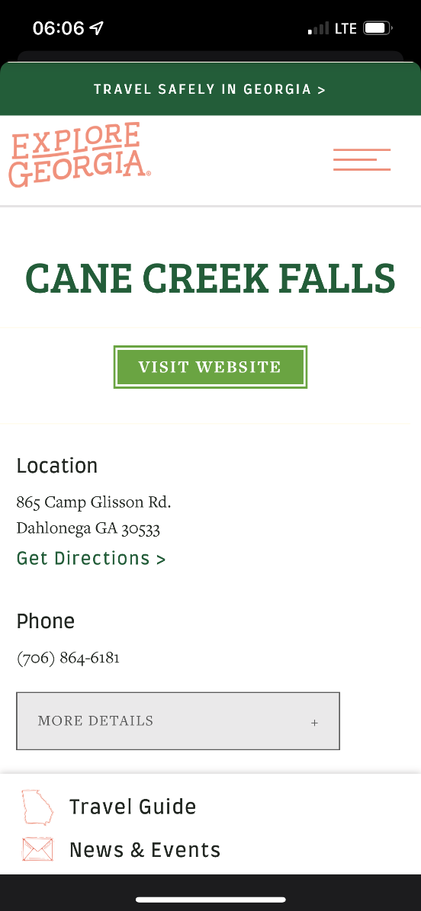
Go Out Here
Click the go out here button to bring up a web view with more information about the location.
The content that appears when you select a place varies depending upon the type of establishment you chose.

Slide 8
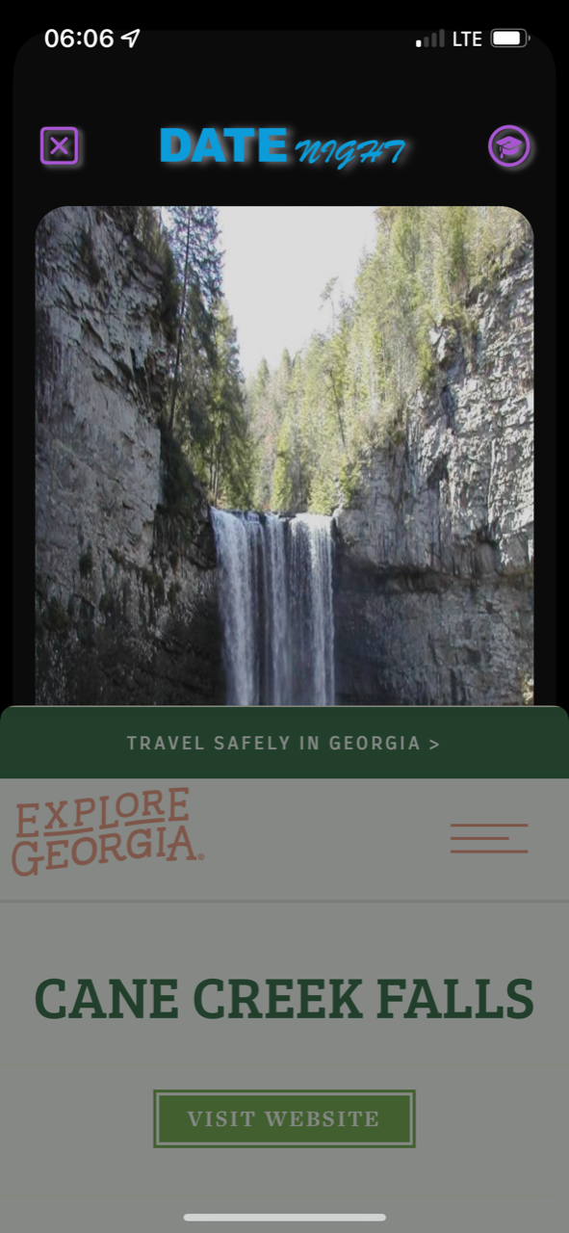
Dismiss
To dismiss the web view, just drag down from the top part of the view.
I found trying to segment the web view with a dedicated dismiss button was too distracting.

Slide 9
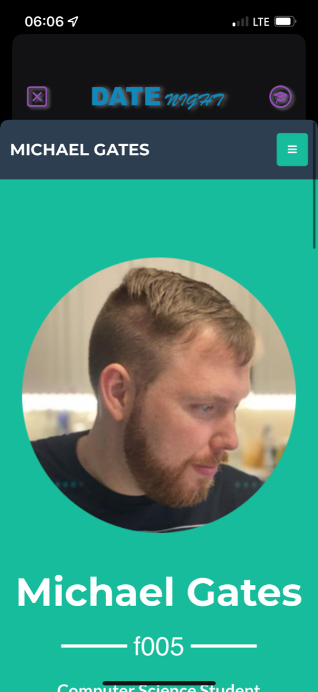
About button
Clicking the graduation cap button brings up a website I made for this app as an “about the developer” item.
I used Dreamweaver and bootstrap for the page.
michael.gateswebs.ga

Slide 10
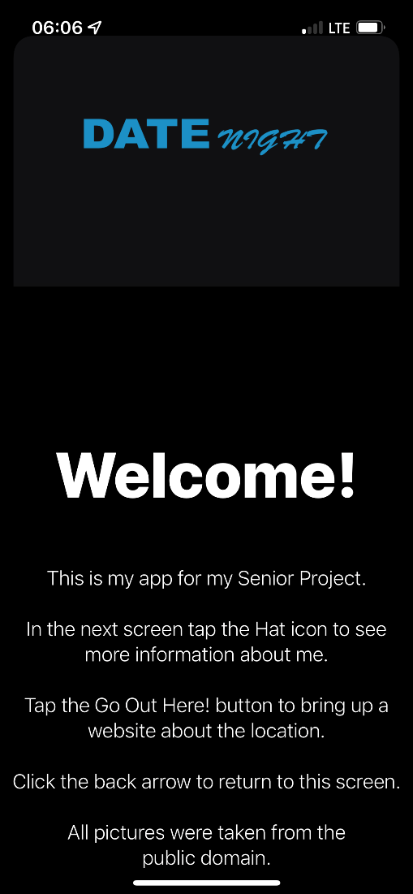
Easter Egg
I always like adding easter eggs to the things I code. If you click one of the emoji on the main page, this hidden view pops up.

Slide 11
End
Thank you for your attention!
I used Adobe Illustrator to make the images for the logo and the app icon.
The heart, cross, and graduation cap icons are built into swift.
Next is to learn flutter to make this, and maybe pay that $99 for the developer program and implement google ads with firebase.

